Slide 1
LLM Initiative

Slide 2
RAG:Retrieval Augmented Generation
Different from Standard seq2seq model, meaning it takes in one sequence and outputs a corresponding sequence.
There is an intermediary step though, which differentiates and elevates RAG above the usual seq2seq methods. Rather than passing the input directly to the generator, RAG instead uses the input to retrieve a set of relevant documents, in our case from Wikipedia.
RAG thus has two sources of knowledge: the knowledge that seq2seq models store in their parameters (parametric memory) and the knowledge stored in the corpus from which RAG retrieves passages (nonparametric memory, ex: documents are stored in Non parametric memory).
These two sources complement each other. We found that RAG uses its nonparametric memory to “cue” the seq2seq model into generating correct responses, essentially combining the flexibility of the “closed-book” or parametric-only approach with the performance of “open-book” or retrieval-based methods.
It is similar to In-context Retrieval-Augmented Learning (IC-RALM) used by GPT3

Slide 3
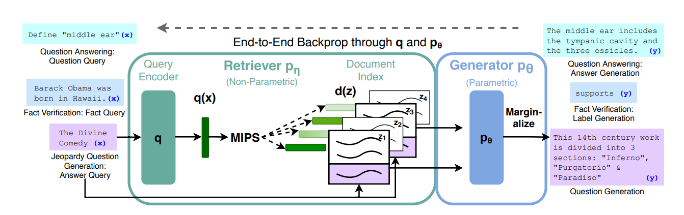
How RAG works?

Slide 4
The query encoder is going to be used to
encode these queries. So anytime we have an x that we're using
say it's just a sequence with a mask at the
end of it we're going to encode that as
a query and then use it to go find the most similar documents in the non-parametric encoded these wikipedia sequences .
So a core idea to this is that we're not going to be training the document encoder at all.

Slide 5
LangChain Framework
Components:
Schema
Model: LLMs, Chat models and Text embedding Models.
The Embeddings class is a class designed for interfacing with text embedding models. There are lots of embedding model providers (OpenAI, Cohere, Hugging Face, etc)
LLms and Chat Models are very similar
Prompts: A prompt refers to the input to the model. This input is often constructed from multiple components.

Slide 6
Indexes
Memory
Chains: Combining LLMs with other components
Chaining in LangChain simply describes the process of combining LLMs with other components to create an application. Some examples are:
Combining LLMs with prompt templates (see this section)
Combining multiple LLMs sequentially by taking the first LLM’s output as the input for the second LLM (see this section)
Combining LLMs with external data, e.g., for question answering (see Indexes)
Combining LLMs with long-term memory, e.g., for chat history (see Memory)
Agents

Slide 7
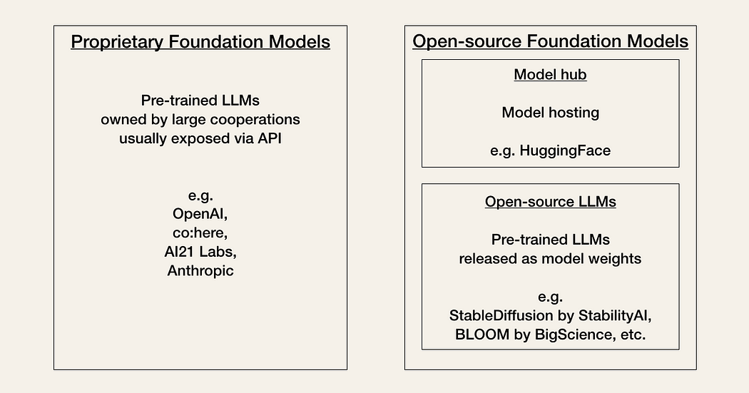
API keys: You will first need an API key for the LLM provider you want to use. Developers must choose between proprietary or open-source foundation models based on a trade-off mainly between performance and cost.

Slide 8
Vector Database— If we want to use a specific vector database such as Pinecone, Weaviate, or Milvus, you need to register with them to obtain an API key and check their pricing.
Faiss, which is an open source vector database with no sign-up .

Slide 9
links
https://towardsdatascience.com/getting-started-with-langchain-a-beginners-guide-to-building-llm-powered-applications-95fc8898732c
https://python.langchain.com/docs/get_started/quickstart
Videos:
https://www.youtube.com/watch?v=_FpT1cwcSLg

Slide 10
Components …..
Memory :
LangChain provides several different options for dealing with chat history :
keep all conversations,
keep the latest k conversations,
summarize the conversation.
Agents: Accessing other tools
Despite being quite powerful, LLMs have some limitations: they lack contextual information (e.g., access to specific knowledge not contained in training data), they can become outdated quickly (e.g., GPT-4 was trained on data before September 2021), and they are bad at math.
Because LLMs can hallucinate on tasks they can’t accomplish on their own, we need to give them access to supplementary tools such as search (e.g., Google Search), calculators (e.g., Python REPL or Wolfram Alpha), and lookups (e.g., Wikipedia).

Slide 11
Links
https://medium.com/mlearning-ai/building-a-simple-ai-application-with-large-language-model-llm-using-langchain-f9769bba68
https://towardsdatascience.com/getting-started-with-langchain-a-beginners-guide-to-building-llm-powered-applications-95fc8898732c#fcac
https://www.youtube.com/watch?v=PzRvUngOF2o
https://medium.com/@basics.machinelearning/tokenization-in-openai-api-lets-explore-tiktoken-library-d02d3ce94b0a

Slide 12
Progress : 26th June
Working with .txt file
Read a txt file
Split using RecursiveCharacterTextSplitter : This creates a “list of langchain schema Documents”
Used Chromadb as Vector Space and Openai for creating Embeddings
Use “persist directory” to store created embeddings of our Documents
Load Embeddings from persist directory

Slide 13
(….continue)
Similarity Search and Retrieving of relevant documents based on query
A retriever does not store documents, only returns (or retrieves) it. Vector stores can be used as the backbone of a retriever, but there are other types of retrievers as well.

Slide 14
Open source Embedding model
1. all-MiniLM-L6-v2
This is a sentence-transformers model: It maps sentences & paragraphs to a 384 dimensional dense vector space and can be used for tasks like clustering or semantic search.
This model is intented to be used as a sentence and short paragraph encoder. Given an input text, it ouptuts a vector which captures the semantic information. The sentence vector may be used for information retrieval, clustering or sentence similarity tasks.
By default, input text longer than 256 word pieces is truncated.
Other Sentence transformer model on Huggingface Hub:
https://www.sbert.net/docs/pretrained_models.html

Slide 15
2. BLOOM (BigScience Large Open-science Open-access Multilingual Language Model)
With its 176 billion parameters (larger than OpenAI’s GPT-3), BLOOM can generate text in 46 natural languages and 13 programming languages. It is trained on 1.6TB of text data

Slide 16
Progress – 3/07/2023
Hugging Face Hub API for models are basically of 2 types:
text2text generation (or seq2seq or Encoder-Decoder) Models
text generation models (or Decoder only) Model
To run the Models locally:
We need to use Huggingface transformers pipeline
Initialize the model depending on your model type i.e. (text2text generation uses AutoModelForSeq2SeqLM, or, text generation which uses AutoModelForCausalLM )
Define pipeline depending on whether it is text2text generation, or, text generation

Slide 17
Starcoder implementation using Huggingface api

Slide 18
Codebase Sustenance
Codebase Sustenance
It is a continuous process that ensures the proper functioning of a product and enhances its lifespan by providing updates and maintenance.
It involves optimizing maintenance strategies, identifying and resolving potential issues, and continuously improving the product or system to meet the changing needs of customers and the marketplace.
The goal of sustenance engineering is to ensure that a product or system remains efficient and effective over the long term.
This involves not only fixing user identified problems as they arise but also proactively identifying potential issues before they become major problems.

Slide 19
Code sustenance refers to the process of maintaining and improving a software codebase over time to ensure its stability, reliability, and longevity. It involves activities such as bug fixing, performance optimization, code refactoring, adding new features, and adapting the codebase to meet changing requirements.
Bug fixing: Identifying and resolving software defects or issues reported by users or detected through testing.
Performance optimization: Analyzing and enhancing the codebase to improve its speed, efficiency, and scalability.
Refactoring: Restructuring the codebase to improve its readability, maintainability, and adherence to coding standards.
Feature enhancement: Adding new features or functionality to meet user requirements or business needs.
Security updates: Applying patches and updates to address security vulnerabilities and ensure the codebase remains secure.

Slide 20
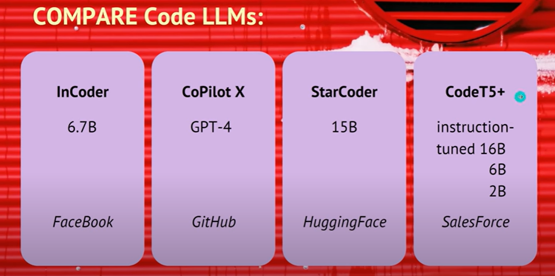
Code LLMs: a brief comparison
SalesForce CodeT5 is open sourced. It is a Encoder-Decoder type of Architecture. It has NO token limit, although memory limitations are obviously there.
Applications of Code LLM:
Text-to-code generation: It can generate code based on the natural language description
Code autocompletion: It can complete the whole function of code given the target function name
Code summarization: It can generate the summary of a function in natural language description

Slide 21
Self Debugging: Paper
Paper proposes SELF-DEBUGGING, which teaches a large language model to debug its predicted program via few-shot demonstrations.
The proposed model is able to identify its mistakes by explaining the generated code in natural language.
Different from prior works on utilizing human feedback for code repair, where the feedback message explains the code errors and how to fix them, SELF-DEBUGGING teaches the model to identify the implementation errors via code explanation(few-shot).
They used “code-davinci-002” for all their experiments with SELF-DEBUGGING

Slide 22
SELF-DEBUGGING Framework
SELF-DEBUGGING with Simple Feedback: The simplest form of automatic feedback is a sentence that just indicates the code correctness without more detailed information.
SELF-DEBUGGING with Unit Tests (UT):
SELF-DEBUGGING via Code Explanation (Expl.): Here, instead of teaching the large language model to predict error messages, we propose to teach the model to self-debug via explaining the generated code. This debugging process is reminiscent of rubber duck debugging, where a programmer debugs code by explaining it line-by-line to a rubber duck [24]. By describing the code implementation and comparing it to the problem description, human programmers are usually able to identify the bugs without extra guidance.

Slide 23
Applications:
Text-to-SQL Generation: The goal of text-to-SQL tasks is to generate the corresponding SQL query given a question and the database information.
Code Translation: The goal is to translate code in one programming language into another language. Such experiments use the dataset, which includes a test set of parallel functions in different programming languages (ex: TransCoder dataset)
Text-to-Python Generation: Generate a python code based on text prompt provided.

Slide 24
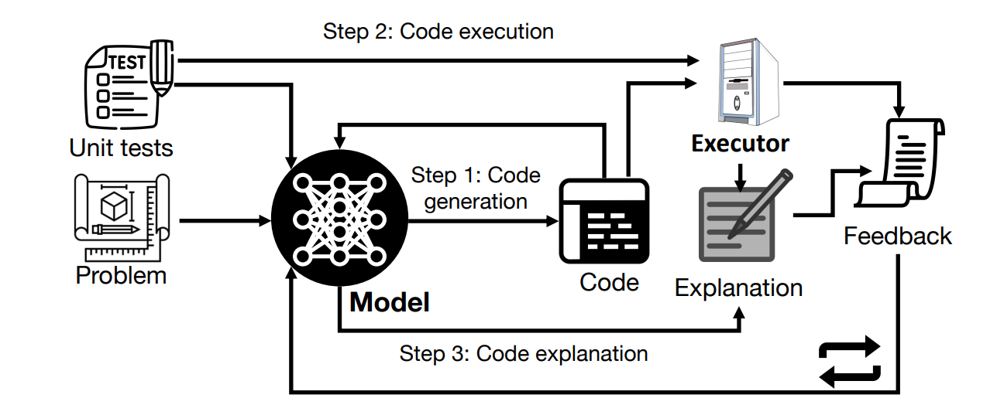
Figure : SELF-DEBUGGING for iterative debugging using a large language model. At each debugging step, the model first generates new code, then the code is executed and the model explains the code. The code explanation along with the execution results constitute the feedback message, which is then sent back to the model to perform more debugging steps. When unit tests are not available, the feedback can be purely based on code explanation.

Slide 25
References:
https://arxiv.org/pdf/2304.05128.pdf
https://www.youtube.com/watch?v=qlHkjmz_bG4&t=3s

Slide 26
GRADIO
INTERFACE::
Interface class can wrap any Python function with a user interface

Slide 27
https://bhadreshpsavani.medium.com/how-to-use-tesseract-library-for-ocr-in-google-colab-notebook-5da5470e4fe0

Slide 28
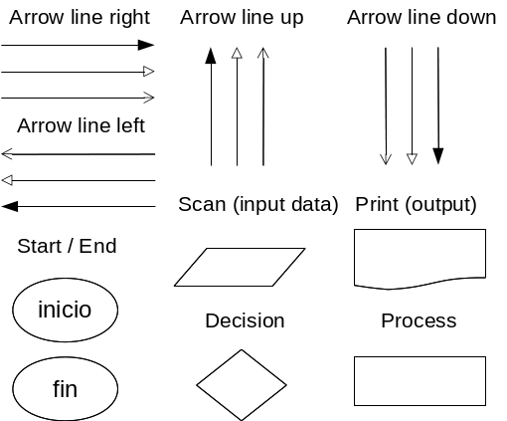
Flowchart Terminologies:

Slide 30
R-CNN v/s Fast RCNN v/s Faster RCNN https://www.youtube.com/watch?v=vr5rs_cTKCs

